Slide 1
AWS Snowball

Slide 2
Agenda
What is a snowball?
Features of snowball.
How data is secured?
When is a snowball used?
Why should we use snowball?
How should we use snowball?
Snowball pricing.

Slide 3
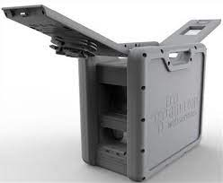
Snowball
Physical storage devices.
Transfer of large amounts of data.
Transfer large amounts of data to save time and money.
To create jobs, track data, and track the status of our jobs.

Slide 4
Features of Snowball
Available in 50 TB model.
Transfer large amounts of data.
Enforced encryption to safeguard our data.
To purchase and maintain their own hardware devices.

Slide 5
Data security
Secured using the AWS Key Management Service.
Amazon S3 and our on-premise data storage location.
Securing and protecting our data in transit.

Slide 6
Snowball use
Large amount of data stored locally.
Move that data to the cloud.
To store on the internet.
Because of security reasons.

Slide 7


Snowball use
Many industries:
Airlines.
VFX houses.
Studios.
Banks.
Hospitals.

Slide 8
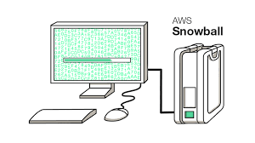
How snowball works?
Process of sending data using snowball.
Physical device will arrive at our location.
To launch the Snowball client application.
Choose the data sources.

Slide 9
Snowball pricing
Pricing of the snowball is cheap
One-fifth of the cost given by other providers.
Very useful.
To transfer huge data securely.

